Slide 1
The Career Aspirations of Gen Z
Presented by
DASARI ANIL

Slide 2
Roadmap
1. Problem Statement
2. Data Collection
3. Data Cleaning (SQL)
4. SQL Analysis
5. Power BI Dashboards
6. Key Insights
7. Recommendations
8. Business Application (Case Study)
9. Conclusion

Slide 3
Problem Statement
Explore and understand the career aspirations of Gen Z, identifying key trends, preferences, and influencing factors to help employers better align with this generation’s expectations.

Slide 4
Data Collection
Google Forms survey targeting Gen Z
Questions on job preferences, work environment, salary expectations, and values
Responses stored in Excel for analysis

Slide 5
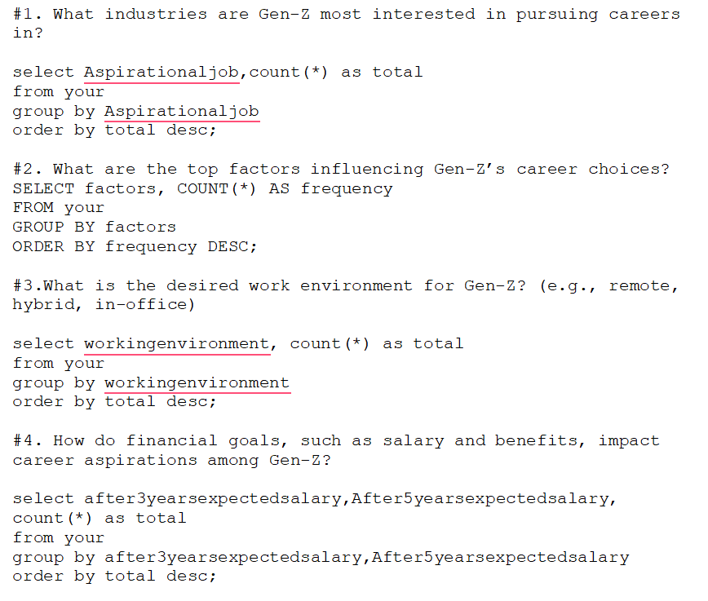
Data Cleaning (SQL)
• Imported into MySQL
• Cleaned text fields and removed blanks/duplicates
• Used joins and CTEs for structured querying

Slide 6
Values & Social Impact
• Purpose-driven careers are top choices
• Strong inclination toward innovation and social good
• Values significantly influence job decisions

Slide 7
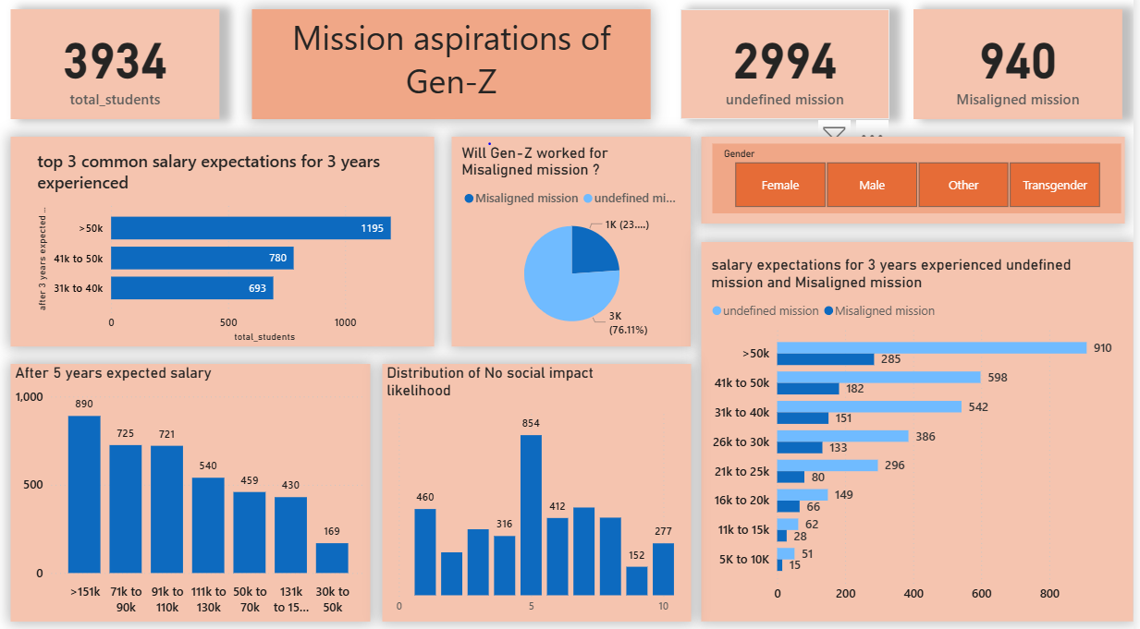
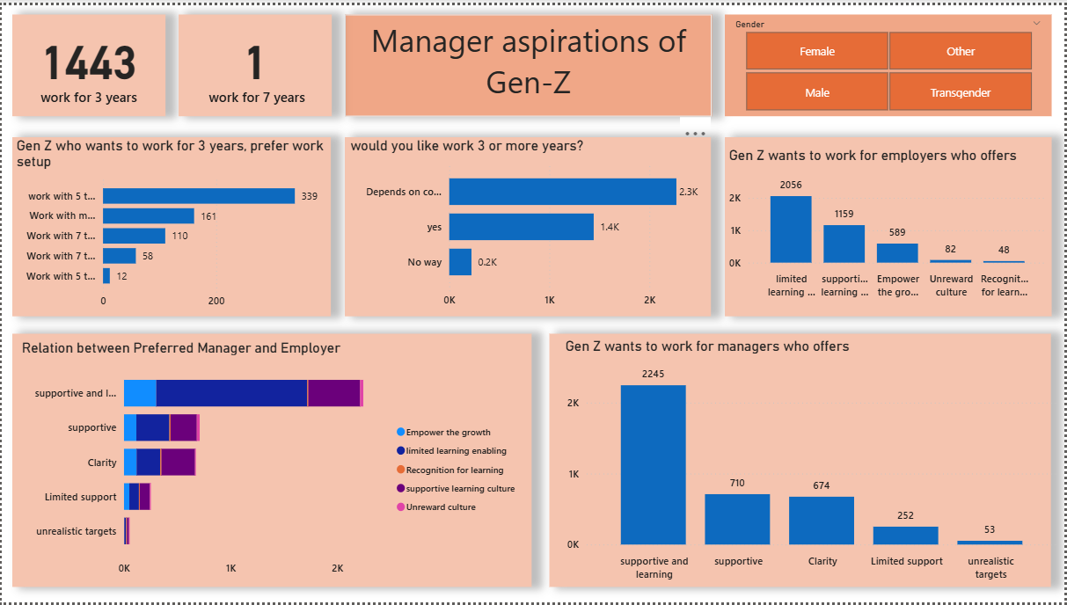
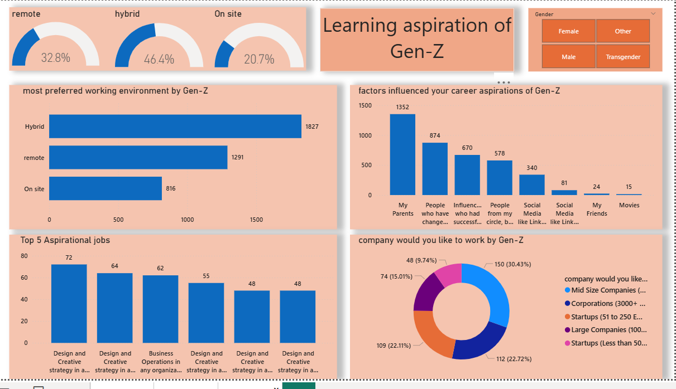
Power BI Dashboards

Slide 8
Key Insights
Most Gen Z expect a salary of >50K after 3 years and >151K after 5 years.
76% are willing to work even if their mission is undefined or misaligned.
Workplace culture significantly influences their decision to stay long-term.
They prefer supportive managers who enable learning and growth.
Large teams and unrealistic targets are generally unattractive to them.
Alignment between manager behavior and employer culture is crucial for retention.

Slide 9
Recommendations
1. Promote flexible work culture
2. Highlight purpose and mission
3. Set realistic salary milestones
4. Align roles with personal values
5. Encourage leadership development

Slide 10
Case Study: Disney’s Data Strategy
• Predicts crowds and optimizes experiences
• Personalizes recommendations and guest interactions
• Uses data to improve engagement and loyalty

Slide 11
Conclusion
• Gen Z’s career path is shaped by flexibility, values, and growth
• Employers must adapt to retain top talent
• Future-ready strategies need data-driven insights

Slide 12
Thank You!

